Slide 1
WEAPONS OF MATH DESTRUCTION
Ethics, Justice and Bias in Algorithms

Slide 2
WHAT IS AN ALGORITHM? Weapons of Math Destruction-Cathy O’Neil
Presented and marketed as objective fact
An opinion imbedded in math
Two things: historical data set and a definition of success

Slide 3
ETHICS VS JUSTICE
sustainable change towards socially just and transparent AI development beyond a framing of “data ethics’’ as competitive advantage
The discourse and practice around socially just AI need to build on a fuller picture of how this technological advancement is imbued by structural inequalities
A focus on just ‘ethics’ and ‘bias’ does not necessitate an acknowledgement of the historic patterns of unequal power structures, discrimination and multi-facetted social inequalities that cause algorithmic and data ‘bias’

Slide 4
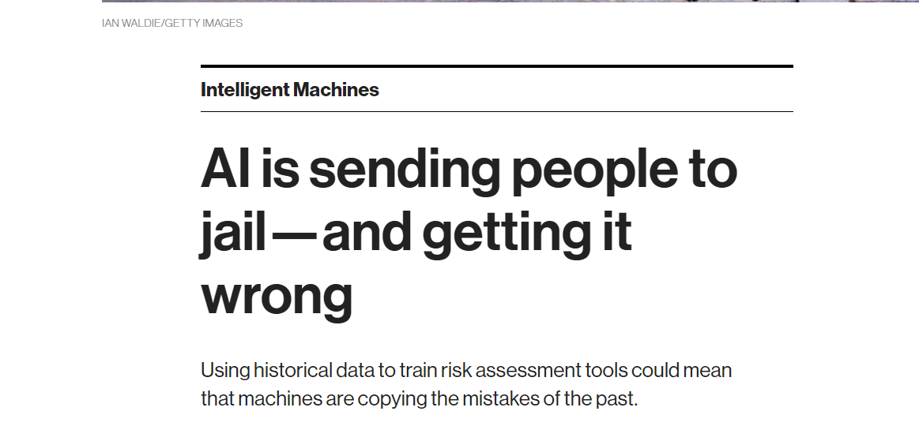

Slide 5
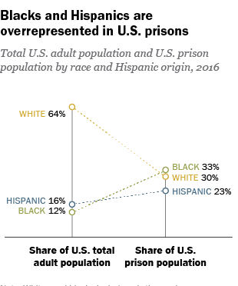
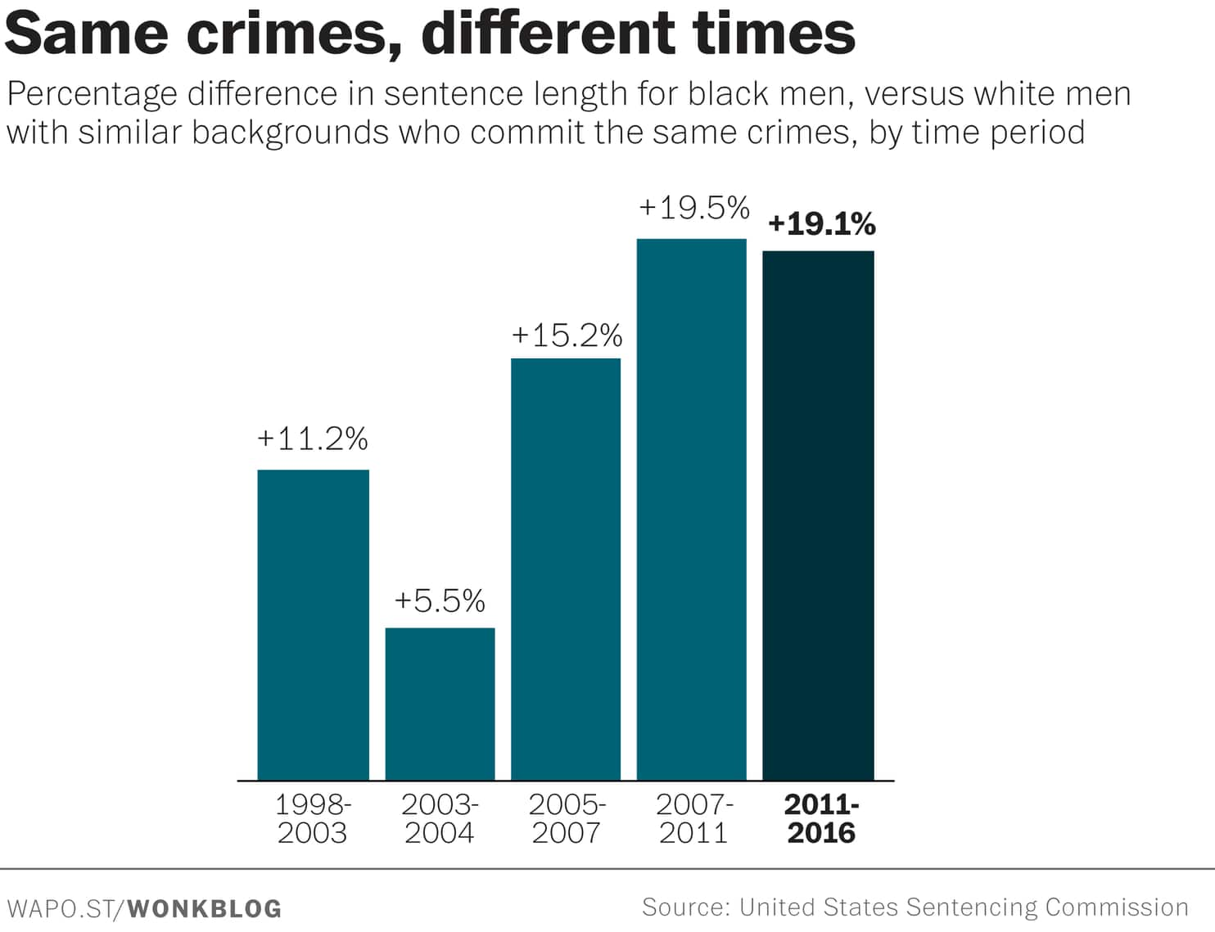

Slide 6
PRISON SENTENCING ALGORITHM
Do you live in a high crime neighborhood?
Have you moved houses 3 or more times in last year?
How do you spend your ‘’leisure time’’?
Do you have a mental health problem?
Are you reliant on social assistance?
WAS SOMEBODY IN YOUR FAMILY IN PRISON?

Slide 7
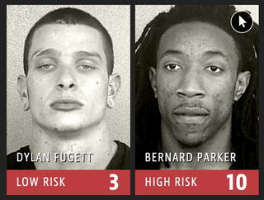

Slide 8
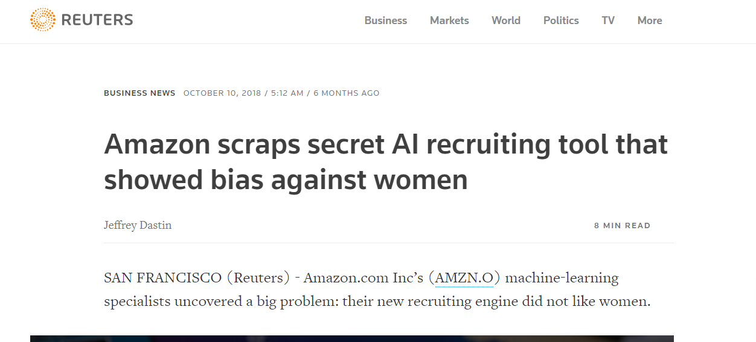

Slide 9
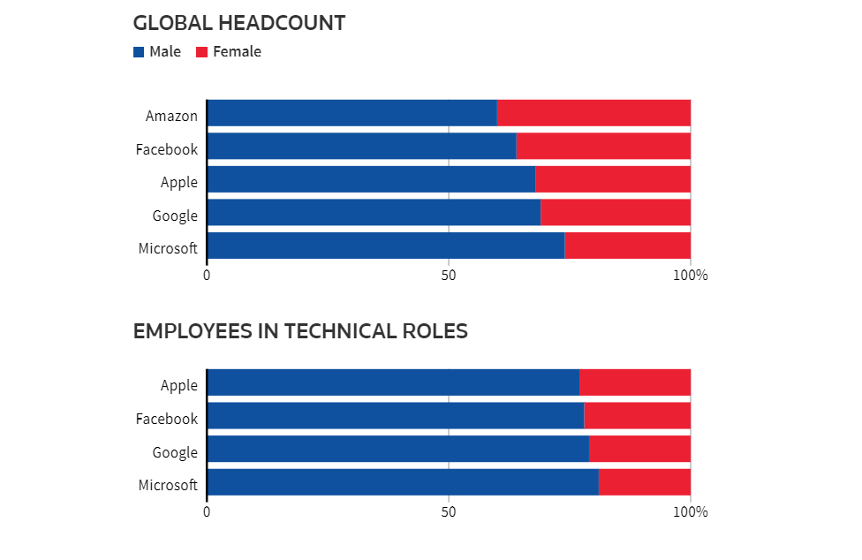

Slide 10
HOW AI BIAS HAPPENS?
Framing the problem
Collecting the data
Preparing the data

Slide 11
LESSONS AND RECOMMENDATIONS?

